Slide 1
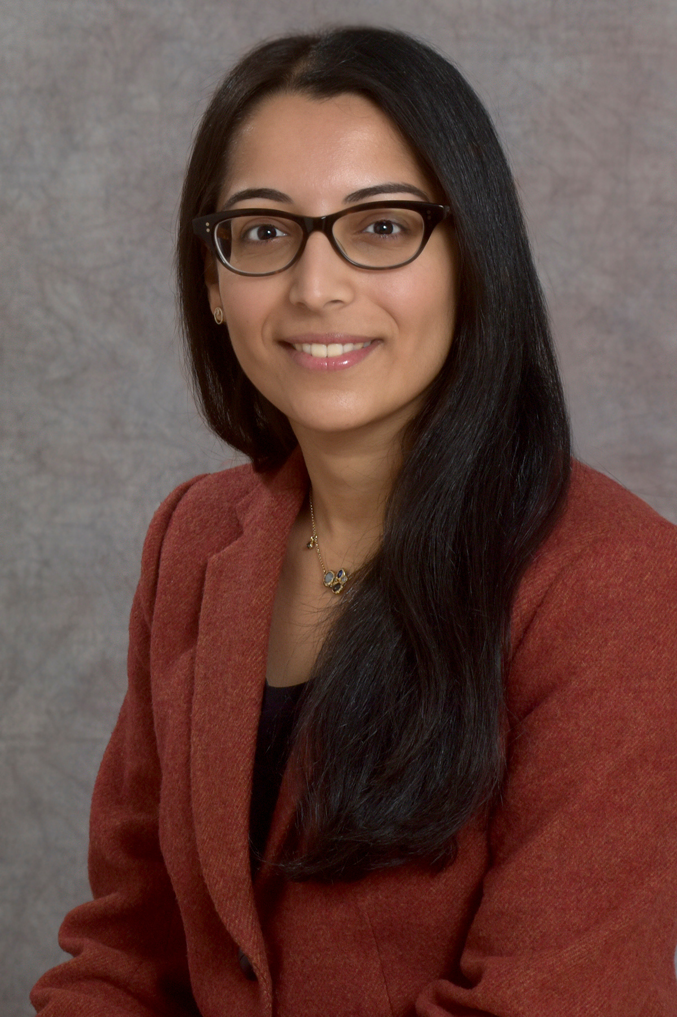

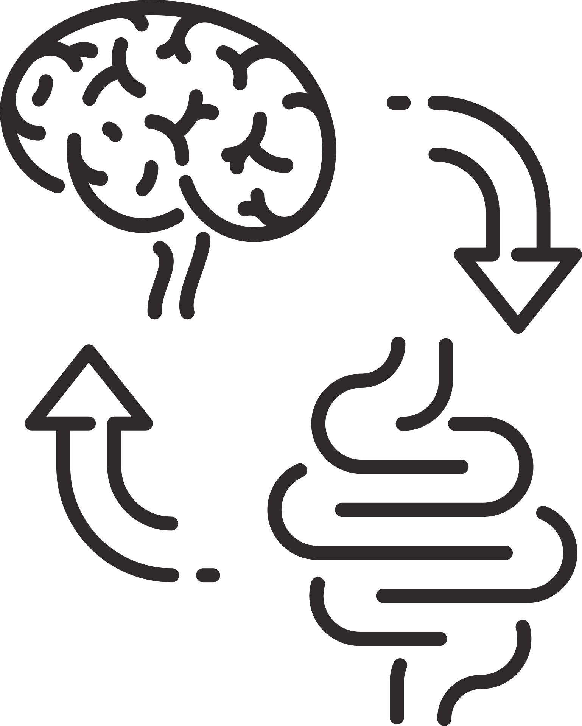


Seminar
NEURAL GASTROENTEROLOGY
Glial biology on the frontlines of the
gut-brain axis
2025/04/23 (三)
11:00 AM - 12:00 PM
臺大醫學院基醫大樓202講堂
Speaker
MEENAKSHI RAO MD, PHD
ASSOCIATE PROFESSOR
BOSTON CHILDREN’S HOSPITAL
HARVARD MEDICAL SCHOOL
主辦單位: 臺大醫學院口生所, 生理所

